Slide 1
GDP Analysis
Gross domestic product (GDP) at current prices is the GDP at the market value of goods and services produced in a country during a year. In other words, GDP measures the 'monetary value of final goods and services produced by a country/state in a given period of time'.
Here using analysis we are going to identity the GDP Rates across the states and whether which state is contributing more towards the GSDP which can contribute more and actual how much contribution is done.

Slide 2
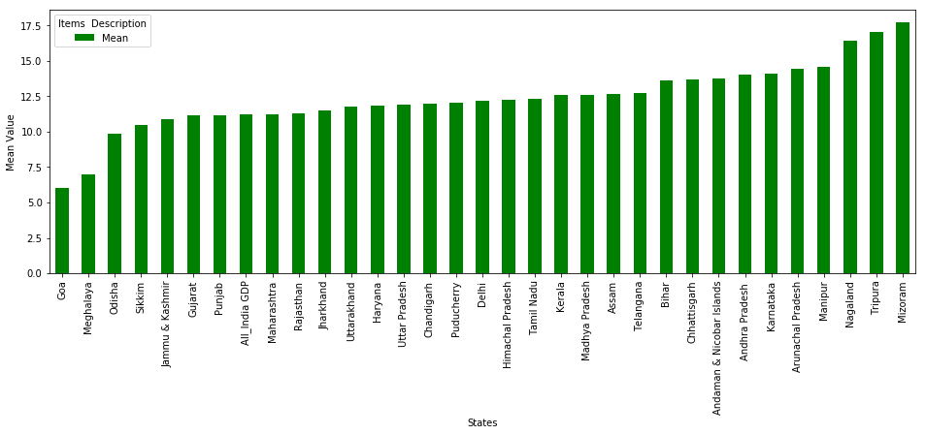
Which states have been growing consistently fast, and which ones have been struggling? In the below Fig 1. Average Growth Rate of Various State, we have calculated the average growth of states for the duration 2013-14, 2014-15 and 2015-16 by taking the mean of the row '(% Growth over previous year’ . Here the State Mizoram is growing consistently fast as compared to other states and also Goa is struggling more than other states. All other states like Puducherry, Delhi, Madhya Pradesh and etc. are doing well not very fast not very slow .
Fig 1. Average Growth Rate of Various State

Slide 3
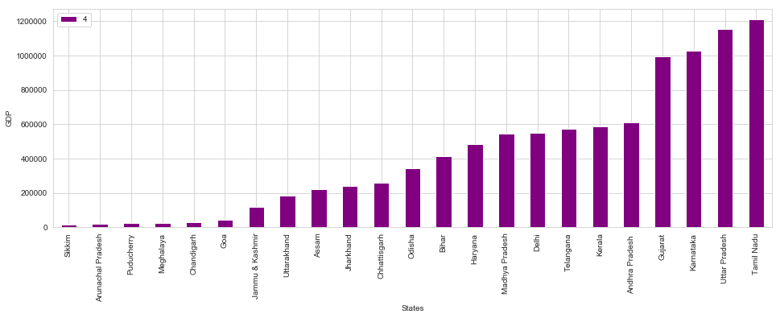
Plot the total GDP of the states for the year 2015-16 Here we have plotted the GDP of each states in ascending to descending format of particular year 2015-16 Here as we can notice the state Tamil Nadu have the highest
Fig 2. Total GDP Of all States

Slide 4
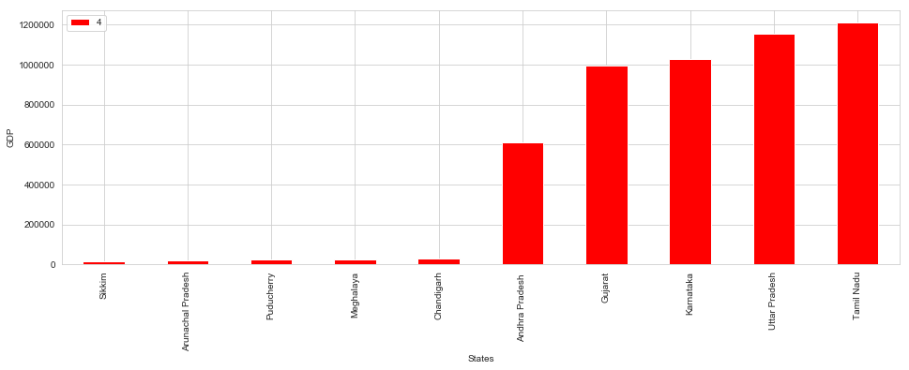
Identify the top 5 and the bottom 5 states based on total GDP Based on our observation the state with highest GDP is Uttar Pradesh and the state with lowest GDP is Arunachal Pradesh
Top 5 states :
Tamil Nadu
Uttar Pradesh
Karnataka
Gujarat
Andhra Pradesh
Bottom 5 :
Sikkim
Arunachal Pradesh
Puducherry
Meghalaya
Chandigarh
Fig 3. Top 5 and Bottom 5 States based on total GDP

Slide 5
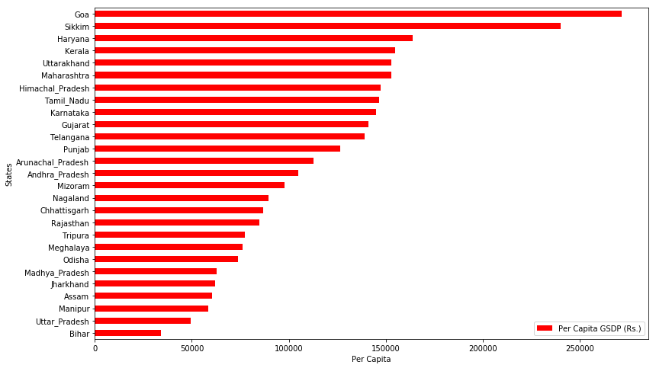
In Fig 4. GDP per capita for all the states. Here we can see that the Goa has the highest GDP Per Capita as compared to all other states. Like wise Bihar has the Lowest GDP Per Capita as compared to all other.
Plot the GDP per capita for all the states
Fig 4. GDP per capita for all the states

Slide 6
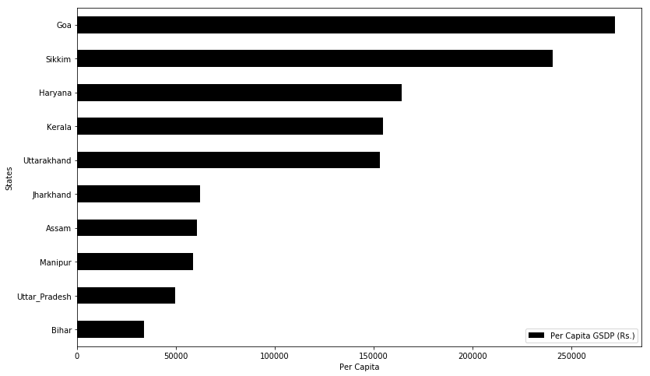
Identify the top 5 and the bottom 5 states based on the GDP per capita.
Top 5 states :
Goa
Sikkim
Haryana
Kerala
Uttarakhand
Bottom 5 :
Bihar
Uttar Pradesh
Manipur
Assam
Jharkhand
Fig 5. top 5 and the bottom 5 states

Slide 7
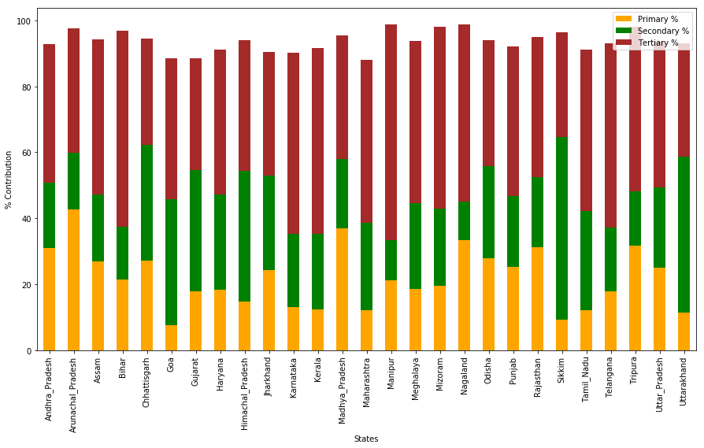
Plot the percentage contribution of the primary, secondary and tertiary sectors as a percentage of the total GDP for all the states
Fig 6. % Contribution of Primary, Secondary & Tertiary sector

Slide 8
In the above Fig 6 . % Contribution of Primary, Secondary & Tertiary sector The Orange colour indicates the Primary sector in each State , Like wise Green Represents the Secondary Sector and Brown Contributes to the Tertiary Sector.
The above fig is a Scattered Bar Graph which represents the % Contribution of each sector according to each states.
Example : Manipur Contributes approximately 98% of Total GSDP where approximately 30% Contributes to the Primary Sector the 20% Contributes to Secondary and the 48% Contributes to the Tertiary Sector.
Manipur Contributes the maximum to Tertiary Sector , Sikkim Contributes more to the Secondary sector and Arunachal Pradesh Contributes more to the Primary Sector.
The above Graph represents the GDP Contribution of Each State in each sectors if the states contribute more in each sector they will automatically contribute more to the GDP Contribution

Slide 9
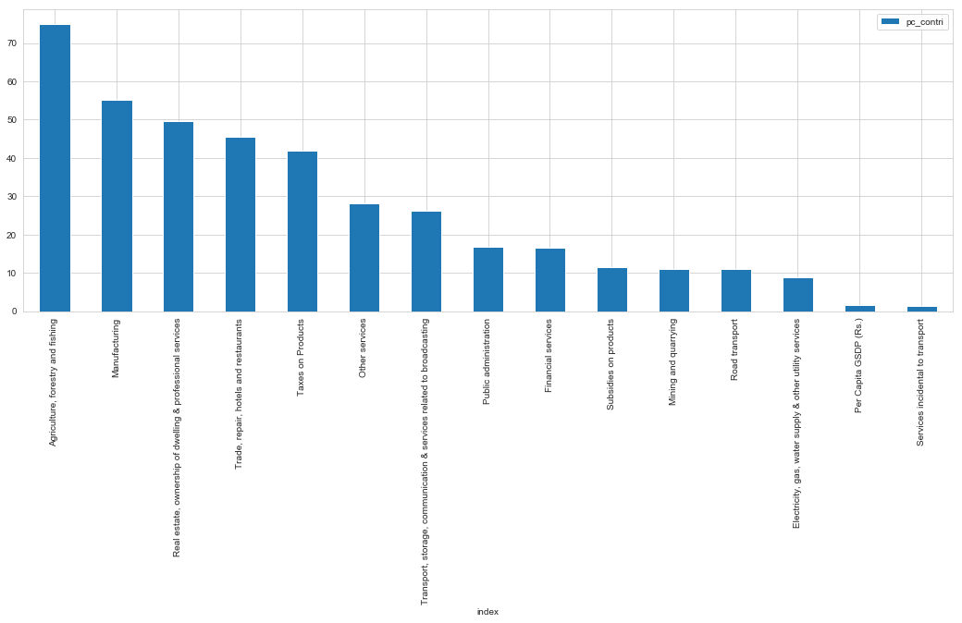
Find the top 3/4/5 sub-sectors (such as agriculture, forestry and fishing, crops, manufacturing etc., not primary, secondary and tertiary) that contribute to approximately 80% of the GSDP of each category.
Fig 7. sub-sectors

Slide 10
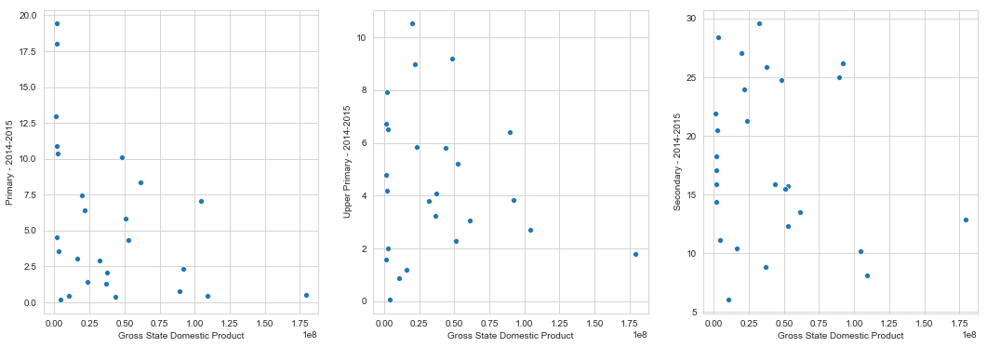
Correlation of GDP per capita with dropout rates in education
As we can notice the, there is a negative correlation between each of the GSDP and the Education Levels.
Using a Scatter Plot we can identify whether there is any correlation of the 2 variables with each other.

